Slide 1
Match volunteers with available opportunities for IRCO
Team 1: Smash the Patriarchy!

Slide 2
Problem and Solution

Slide 3
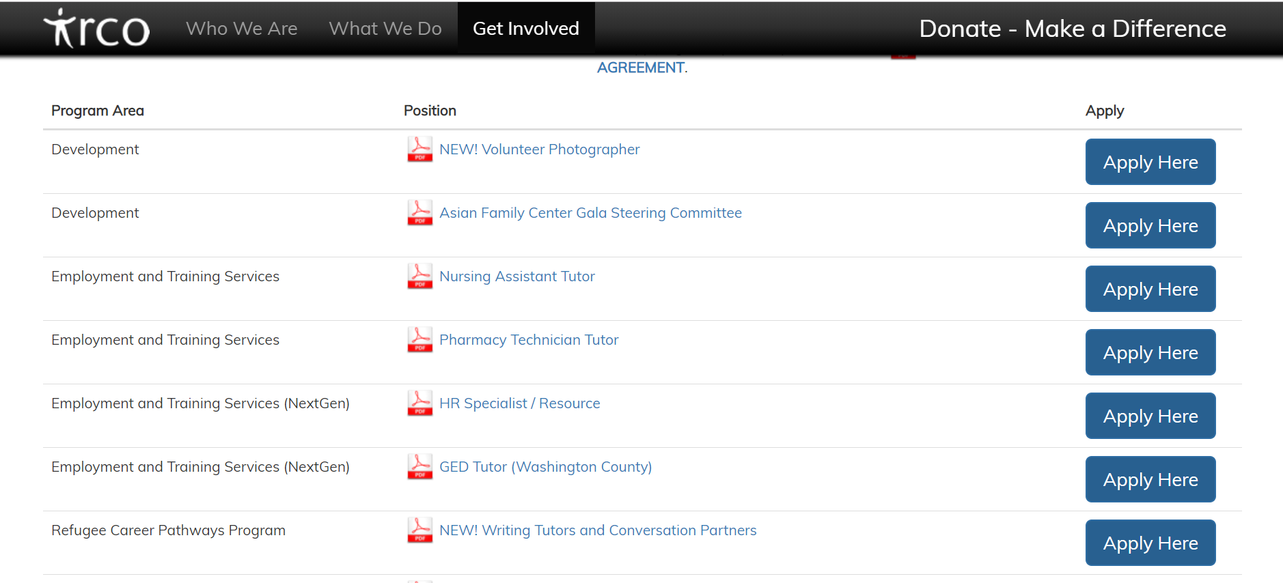
Current Layout

Slide 4
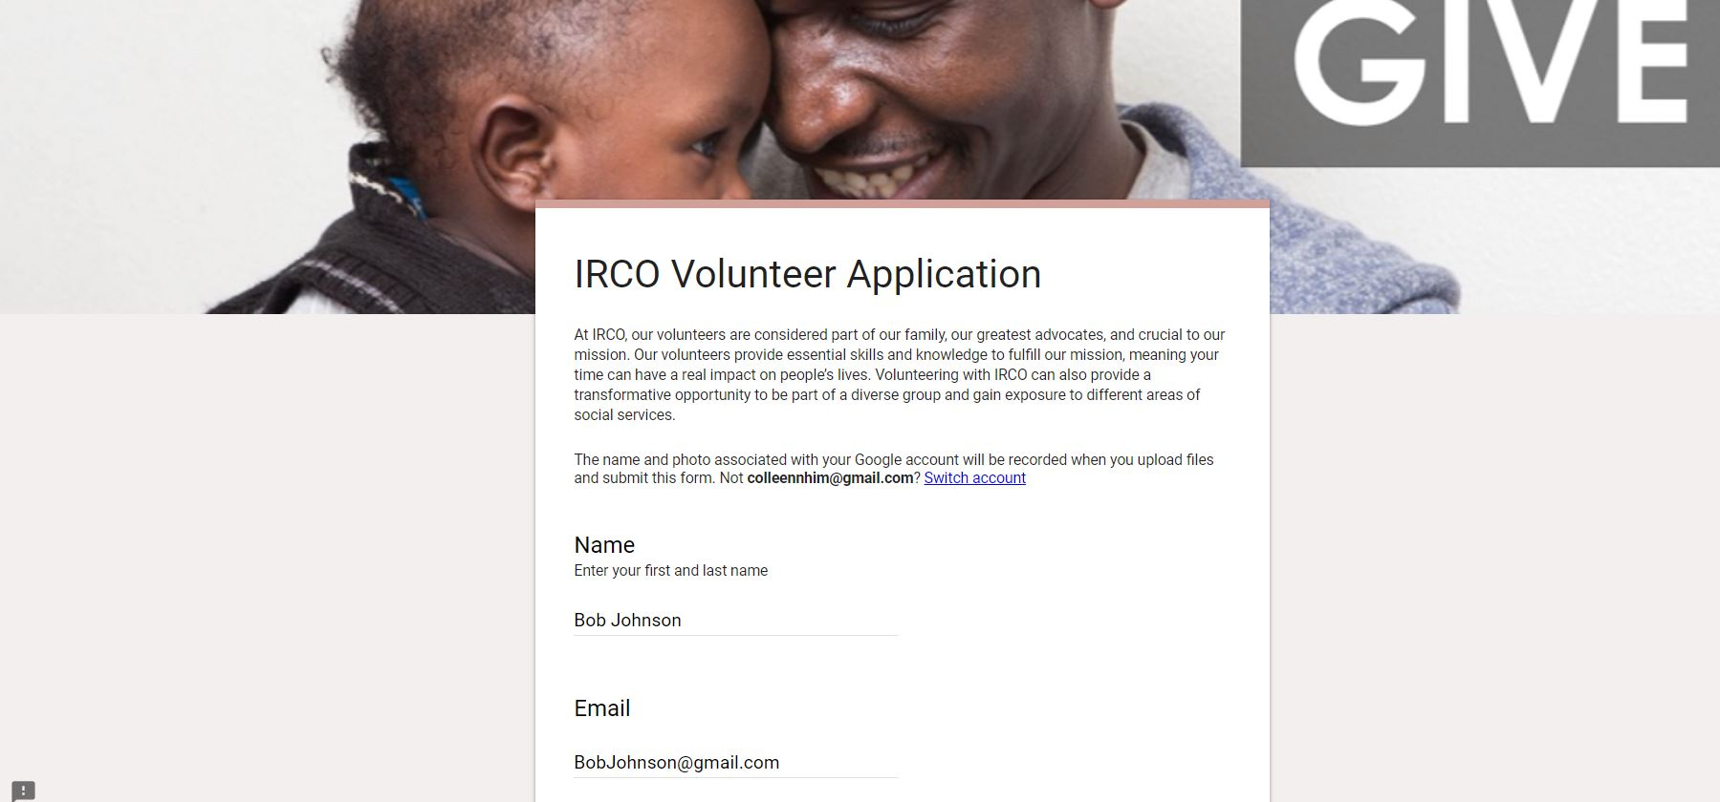
Our Solution

Slide 5
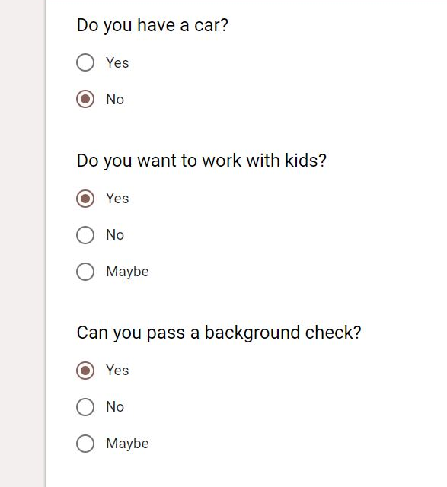
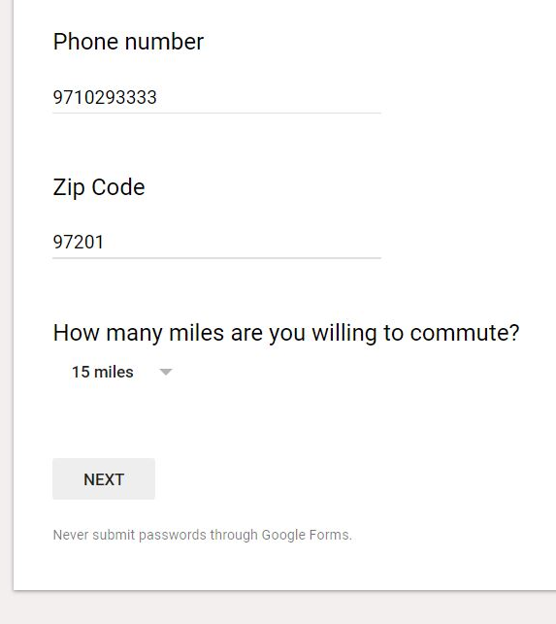
Our Solution

Slide 6
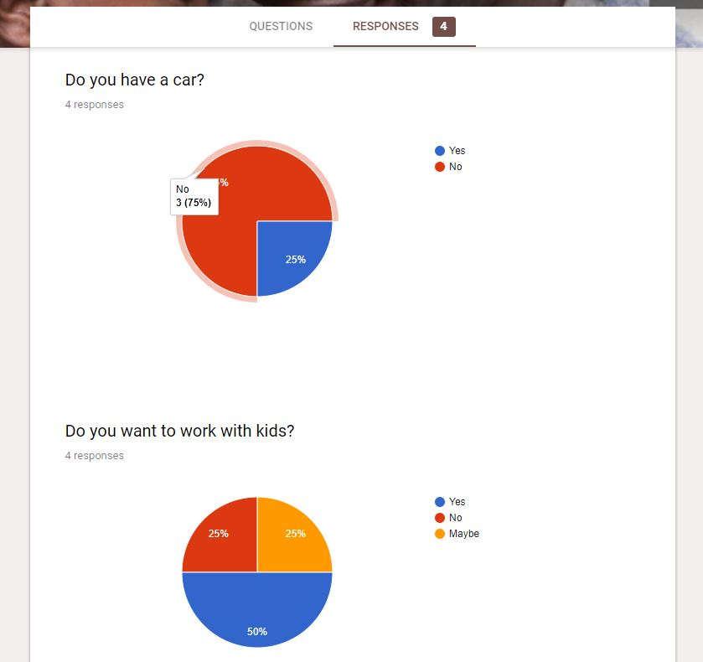
Response Results

Slide 7
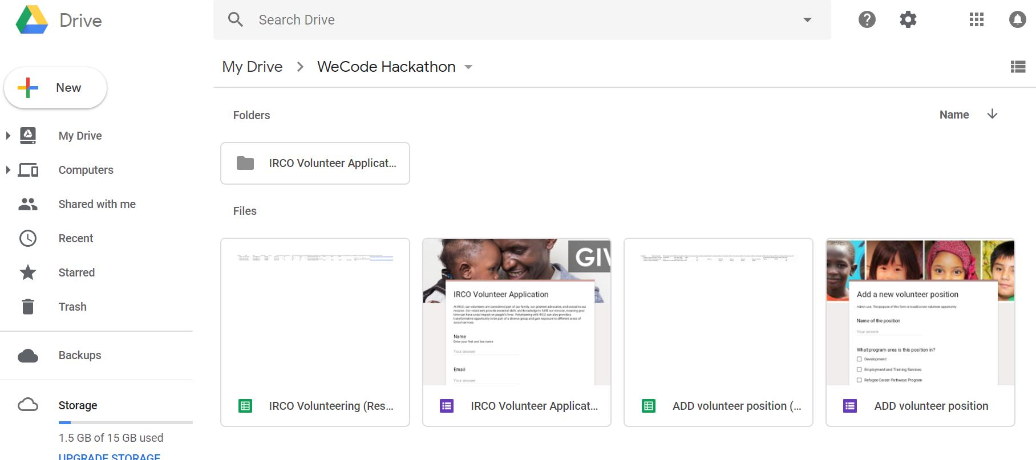
Everything in Drive (Form, Responses, Resumes)

Slide 8
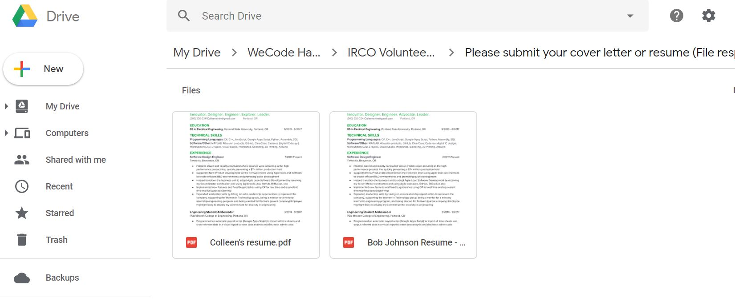
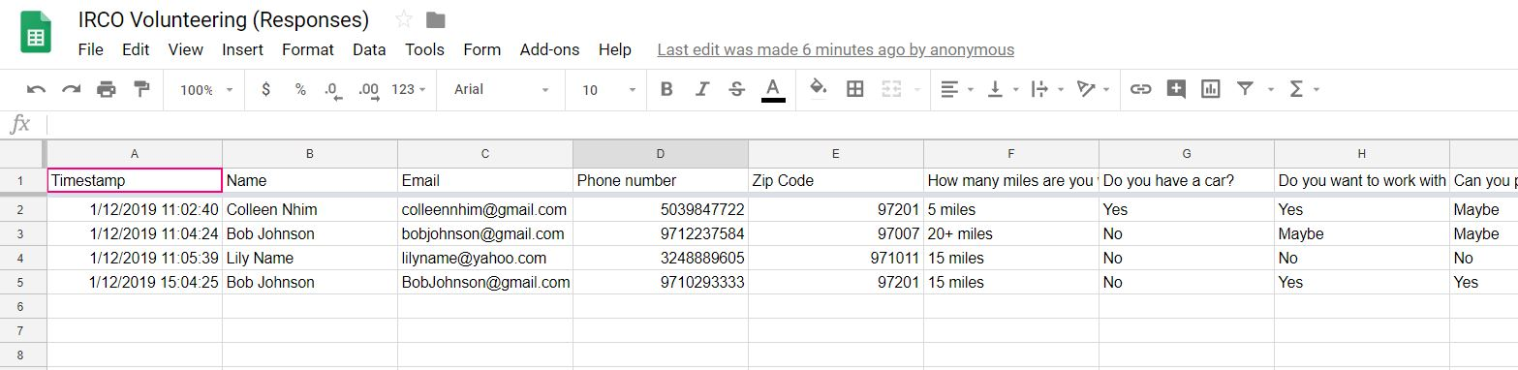

Slide 9
